Slide 1
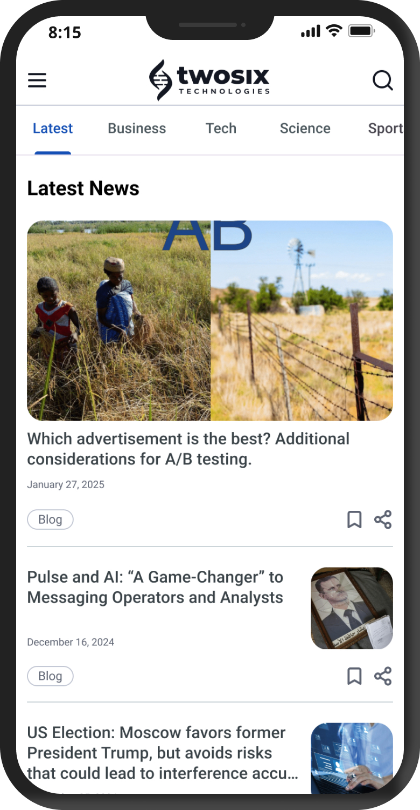
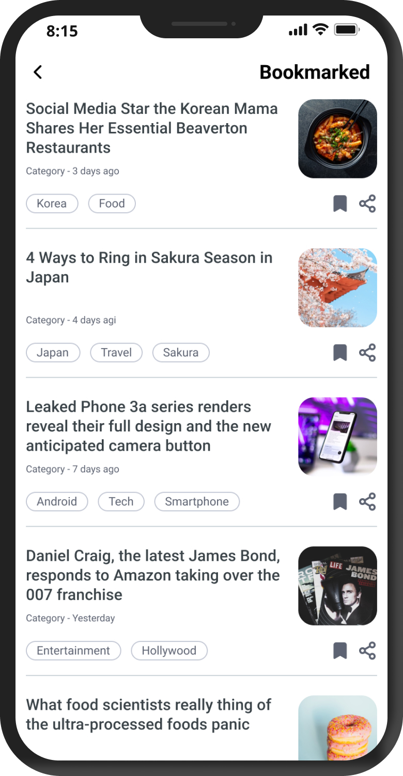
Two Six
Native news mobile application
To better serve their community with daily updates and insights from their Pulse platform, Two Six Technologies decided to transition from email delivery to a dedicated mobile app. Affirma was tasked with designing the TST/Pulse Insights App, starting with an MVP to facilitate a quick launch and gather user feedback. We focused on essential launch features: allowing users to seamlessly share, bookmark, and search for valuable content, thereby creating an accessible and convenient channel for the TST community to stay informed.
Project Team:
4 People
Project Duration:
4 weeks
Services:
Comparative analysis
Wireframing
Prototyping
Development
UI Design

